Slide 1
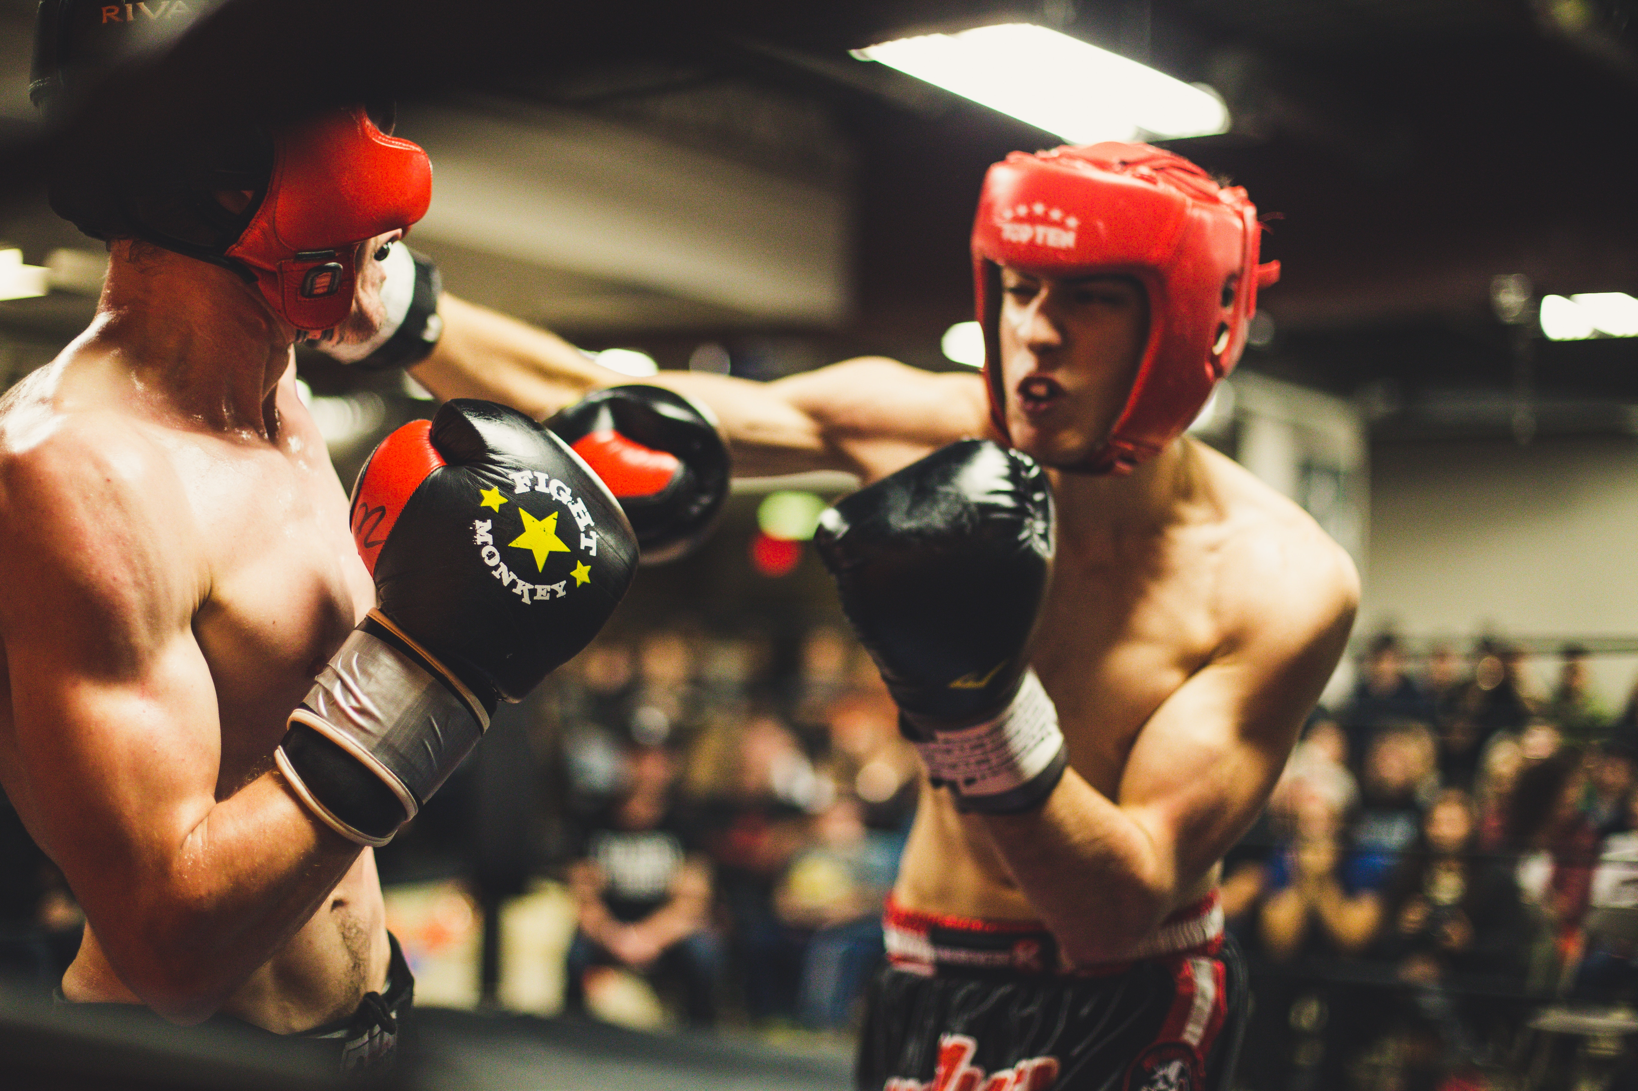
BUZZ VS. BITE A Study of Alcohol and Bitterness in American Craft Beers

Slide 2
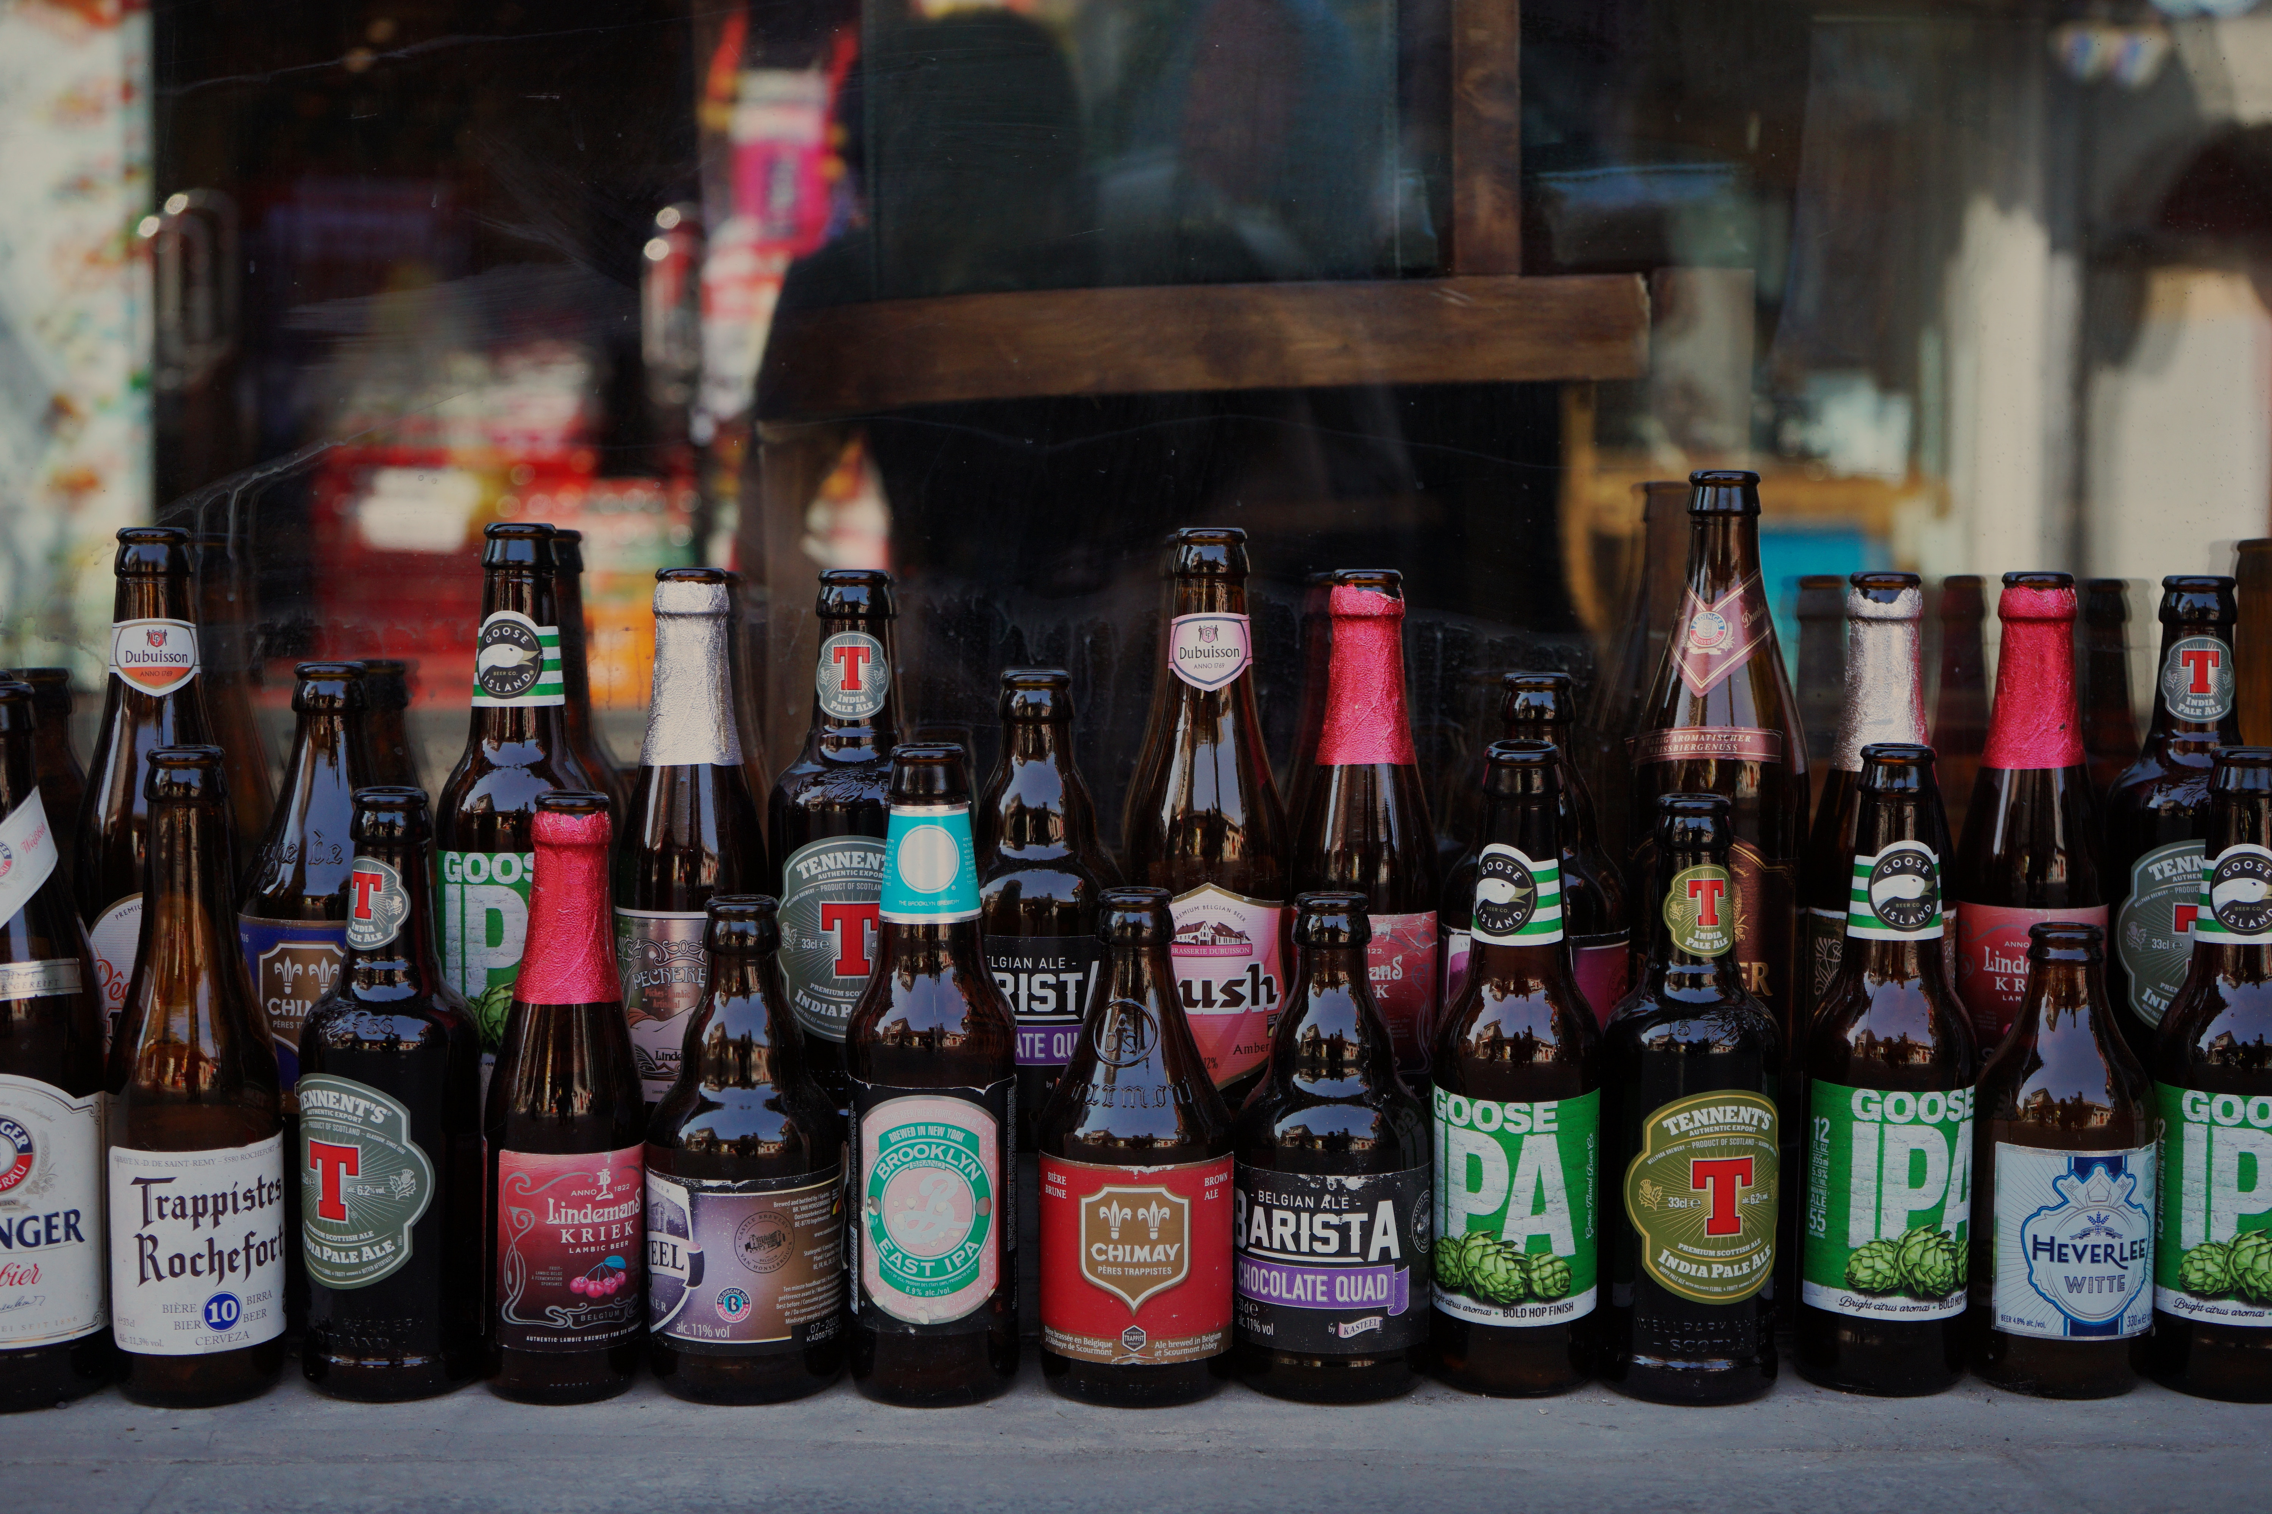
Why Study American Craft Beer
To understand the “lay of the land”
To identify popular beer markets
To find the ”magic formula”

Slide 3
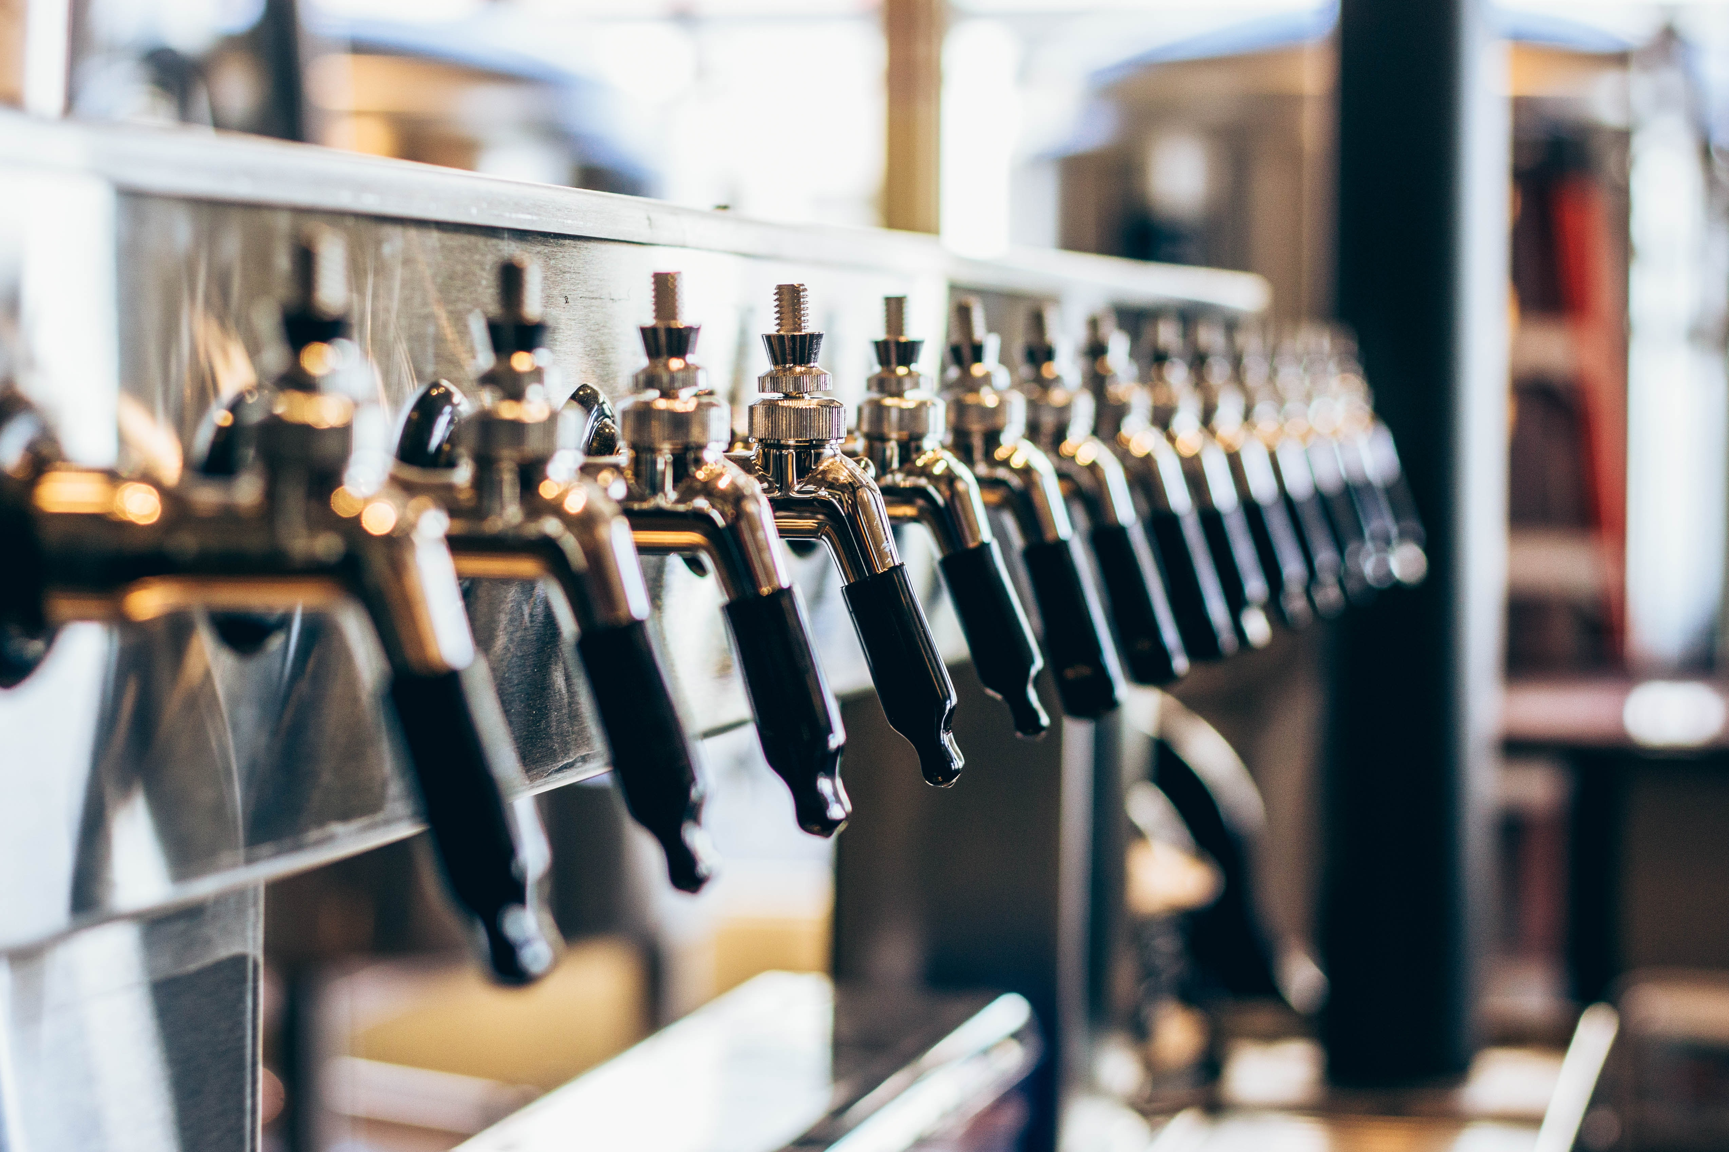
How did we do this?
Gather the data
Clean the data
Explore the data
Analyze the data

Slide 4
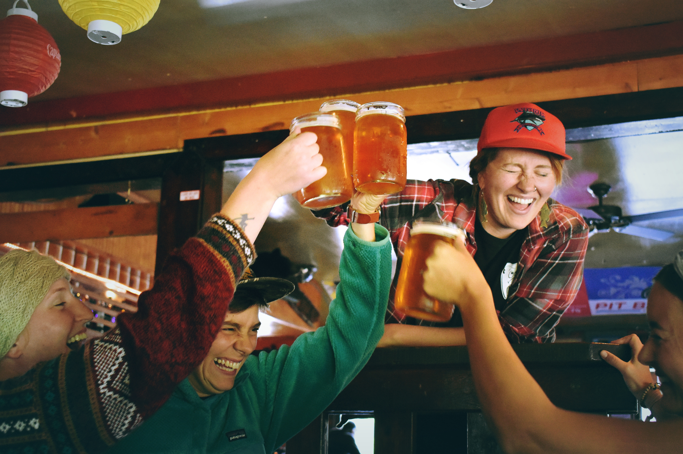
What we found
Beer is brewed ”everywhere”
Wide variety of styles and flavors
There is a slight positive correlation between ABV and IBU

Slide 5
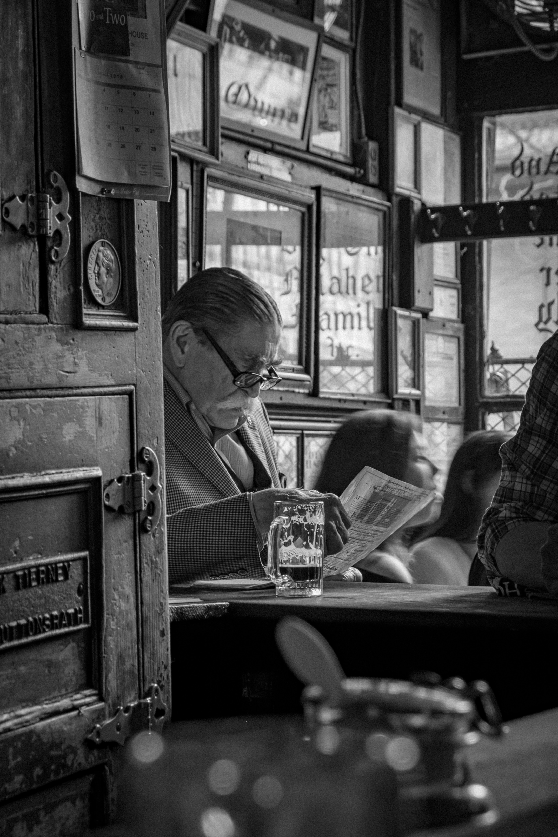
Why this matters
There is no “magic formula”…
…but there is a general guideline
There is a market for all but the most extreme beers
Balance is key. For a given ABV, the American market responds best to a balancing level of bitterness

Slide 6

Reproduce this report
Code for reproducing this report can be found at the following link: https://github.com/la-mar/DDS_Case_Study_1/

